Slide 1
ICT - 4231 OBJECT ORIENTED SOFTWARE ENGINEERING
Lecture - 4
Chapter – 4 : Requirements Elicitation
Mehrin Anannya
Assistant Professor, IIT, JU

Slide 2
Contents
Introduction
An Overview of Requirements Elicitation
Requirements Elicitation Concepts
Requirements Elicitation Activities
Managing Requirements Elicitation

Slide 3
Text Book
Object-oriented Software Engineering: Using UML, Patterns, and Java; 3rd Edition; Bernd Bruegge, Allen H. Dutoit

Slide 4
Introduction
Chapter – 4 : Requirements Elicitation
“
A common mistake that people make when trying to design something completely foolproof is to underestimate the ingenuity of complete fools.
”
-----Douglas Adams, in Mostly Harmless

Slide 5
Introduction
Chapter – 4 : Requirements Elicitation
A requirement is a feature that the system must have or a constraint that it must satisfy to be accepted by the client. Requirements engineering aims at defining the requirements of the system under construction.
Requirements engineering includes two main activities;
requirements elicitation, which results in the specification of the system that the client understands, and
analysis, which results in an analysis model that the developers can unambiguously interpret.

Slide 6
Introduction (Cont.)
Chapter – 4 : Requirements Elicitation
Requirements elicitation is challenging due to the collaboration of diverse groups with varying expertise. Clients and users understand their domain but lack software development experience, while developers have system-building expertise but may not grasp user environments.
Scenarios and use cases bridge this gap, describing system use in natural language. The focus is on scenario-based elicitation, where developers observe and interview users, creating as-is scenarios and visionary scenarios. The client and users validate these through reviews and prototype testing.
As system definition matures, consensus is reached on a requirements specification encompassing functional and nonfunctional requirements, use cases, and scenarios. Effective communication is crucial to avoid costly errors, such as missing functionality or misleading interfaces.
Elicitation methods aim to enhance communication, involving observation, prototype construction, and user feedback. Prototypes offer a glimpse into system usage without full functionality implementation.

Slide 7
An Overview of Requirements elicitation
Chapter – 4 : Requirements Elicitation
Requirements elicitation collaboratively defines the system's purpose, creating a contract between clients and developers known as a requirements specification. Concurrently, during analysis, a formal or semiformal notation results in an analysis model representing the same information.
While the requirements specification aids communication with clients and users in natural language, the analysis model facilitates communication among developers using a more formal approach.
Both aim to accurately represent external aspects of the system. The process, iterative and concurrent, focuses solely on the user's perspective, covering functionality, interaction, error handling, and environmental conditions. Aspects like system structure, implementation technology, and design are excluded from the requirements.

Slide 8
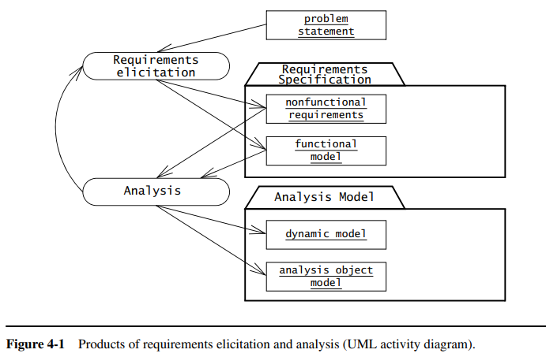
An Overview of Requirements elicitation
Chapter – 4 : Requirements Elicitation

Slide 9
An Overview of Requirements elicitation
Chapter – 4 : Requirements Elicitation
Requirements elicitation includes the following activities:
Identifying actors.
Identifying scenarios.
Identifying use cases.
Refining use cases.
Identifying relationships among use cases.
Identifying nonfunctional requirements.
During requirements elicitation, developers access many different sources of information, including client-supplied documents about the application domain, manuals and technical documentation of legacy systems that the future system will replace, and most important, the users and clients themselves.
We focus on two methods for eliciting information, making decisions with users and clients, and managing dependencies among requirements and other artifacts:
Joint Application Design (JAD) focuses on building consensus among developers, users, and clients by jointly developing the requirements specification.
Traceability focuses on recording, structuring, linking, grouping, and maintaining dependencies among requirements and between requirements and other work products

Slide 10
Requirements Elicitation Concepts
Chapter – 4 : Requirements Elicitation
Requirements elicitation concepts includes the following concepts:
Functional Requirements
Nonfunctional Requirements
Completeness, Consistency, Clarity, and Correctness
Realism, Verifiability, and Traceability
Greenfield Engineering, Reengineering, and Interface Engineering

Slide 11
Functional Requirements
Chapter – 4 : Requirements Elicitation
Functional requirements describe the interactions between the system and its environment independent of its implementation. The environment includes the user and any other external system with which the system interacts. For example,
The above functional requirements focus only on the possible interactions between SatWatch and its external world (i.e., the watch owner, GPS, and WebifyWatch). The above description does not focus on any of the implementation details (e.g., processor, language, display technology).
SatWatch is a wrist watch that displays the time based on its current location. SatWatch uses GPS satellites (Global Positioning System) to determine its location and internal data structures to convert this location into a time zone.
The information stored in SatWatch and its accuracy measuring time is such that the watch owner never needs to reset the time. SatWatch adjusts the time and date displayed as the watch owner crosses time zones and political boundaries. For this reason, SatWatch has no buttons or controls available to the user.
SatWatch determines its location using GPS satellites and, as such, suffers from the same limitations as all other GPS devices (e.g., inability to determine location at certain times of the day in mountainous regions). During blackout periods, SatWatch assumes that it does not cross a time zone or a political boundary. SatWatch corrects its time zone as soon as a blackout period ends.
SatWatch has a two-line display showing, on the top line, the time (hour, minute, second, time zone) and on the bottom line, the date (day, date, month, year). The display technology used is such that the watch owner can see the time and date even under poor light conditions.
When political boundaries change, the watch owner may upgrade the software of the watch using the WebifyWatch device (provided with the watch) and a personal computer connected to the Internet.

Slide 12
Nonfunctional Requirements
Chapter – 4 : Requirements Elicitation
Nonfunctional requirements describe aspects of the system that are not directly related to the functional behavior of the system. Nonfunctional requirements include a broad variety of requirements that apply to many different aspects of the system, from usability to performance. The FURPS+ model2 used by the Unified Process provides the following categories of nonfunctional requirements:
Usability is centered on how easily users can learn, operate, and interpret outputs within a system or component. This encompasses factors like adhering to user interface conventions, determining the scope of online help, and specifying the level of user documentation.
Reliability focuses on a system's ability to perform its necessary functions under specified conditions for a predetermined period. This involves aspects such as mean time to failure, the system's capacity to detect specified faults, and its resilience against security attacks.
Performance requirements are concerned with quantifiable attributes, including how quickly a system reacts to user inputs (response time), the amount of work it can accomplish within a specified time (throughput), its operational and accessible degree (availability), and the precision of its operations.
Supportability requirements address the ease of implementing changes to the system post-deployment. This encompasses adaptability to handle additional application domain concepts, maintainability for incorporating new technology or fixing defects, and internationalization to accommodate various international conventions such as languages, units, and number formats. The ISO 9126 standard, akin to the FURPS+ model, replaces supportability with maintainability and portability, focusing on the ease of system transferability and adaptability across different environments.

Slide 13
Completeness, Consistency, Clarity, and Correctness
Chapter – 4 : Requirements Elicitation
Requirements are continuously validated with the client and the user. Validation is a critical step in the development process, given that both the client and the developer depend on the requirements specification. Requirement validation involves checking that the specification is complete, consistent, unambiguous, and correct.
It is complete if all possible scenarios through the system are described, including exceptional behavior (i.e., all aspects of the system are represented in the requirements model).
The requirements specification is consistent if it does not contradict itself.
The requirements specification is unambiguous if exactly one system is defined (i.e., it is not possible to interpret the specification two or more different ways).
A specification is correct if it represents accurately the system that the client needs and that the developers intend to build (i.e., everything in the requirements model accurately represents an aspect of the system to the satisfaction of both client and developer).

Slide 14
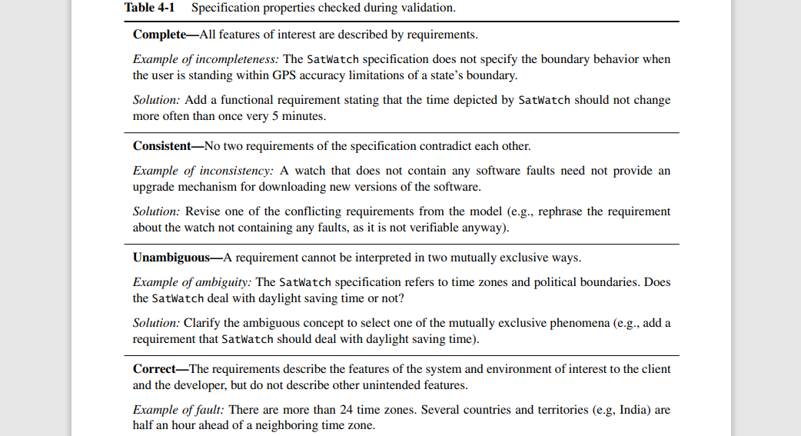
Completeness, Consistency, Clarity, and Correctness
Chapter – 4 : Requirements Elicitation

Slide 15
Realism, Verifiability, and Traceability
Chapter – 4 : Requirements Elicitation
Three more desirable properties of a requirements specification are that it be realistic, verifiable, and traceable.
The requirements specification is realistic if the system can be implemented within constraints.
The requirements specification is verifiable if, once the system is built, repeatable tests can be designed to demonstrate that the system fulfills the requirements specification. For example, a mean time to failure of a hundred years for SatWatch would be difficult to verify (assuming it is realistic in the first place).
A requirements specification is traceable if each requirement can be traced throughout the software development to its corresponding system functions, and if each system function can be traced back to its corresponding set of requirements. Traceability includes also the ability to track the dependencies among requirements, system functions, and the intermediate design artifacts, including system components, classes, methods, and object attributes. Traceability is critical for developing tests and for evaluating changes.

Slide 16
Greenfield Engineering, Reengineering, and Interface Engineering
Chapter – 4 : Requirements Elicitation
Requirements elicitation activities can be classified into three categories, depending on the source of the requirements.
In greenfield engineering, the development starts from scratch—no prior system exists—so the requirements are extracted from the users and the client. A greenfield engineering project is triggered by a user need or the creation of a new market. SatWatch is a greenfield engineering project.
A reengineering project is the redesign and reimplementation of an existing system triggered by technology enablers or by business processes. Sometimes, the functionality of the new system is extended, but the essential purpose of the system remains the same. The requirements of the new system are extracted from an existing system.
An interface engineering project is the redesign of the user interface of an existing system. The legacy system is left untouched except for its interface, which is redesigned and reimplemented. This type of project is a reengineering project in which the legacy system cannot be discarded without entailing high costs

Slide 17
Requirements Elicitation Activities
Chapter – 4 : Requirements Elicitation
Requirements elicitation activities include:
Identifying Actors
Identifying Scenarios
Identifying Use Cases
Refining Use Cases
Identifying Relationships Among Actors and Use Cases
Identifying Initial Analysis Objects
Identifying Nonfunctional Requirements

Slide 18
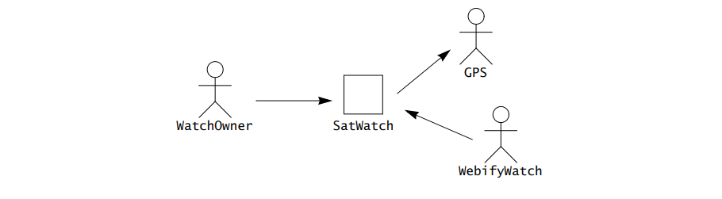
Identifying Actors
Chapter – 4 : Requirements Elicitation
Actors represent external entities that interact with the system. An actor can be human or an external system. In the SatWatch example, the watch owner, the GPS satellites, and the WebifyWatch serial device are actors (see Figure 4-4). They all exchange information with the SatWatch. Note, however, that they all have specific interactions with SatWatch: the watch owner wears and looks at her watch; the watch monitors the signal from the GPS satellites; the WebifyWatch downloads new data into the watch. Actors define classes of functionality.

Slide 19
Identifying Actors
Chapter – 4 : Requirements Elicitation
Consider a more complex example, FRIEND, a distributed information system for accident management. It includes many actors, such as FieldOfficer, who represents the police and fire officers who are responding to an incident, and Dispatcher, the police officer responsible for answering 911 calls and dispatching resources to an incident. FRIEND supports both actors by keeping track of incidents, resources, and task plans. It also has access to multiple databases, such as a hazardous materials database and emergency operations procedures. The FieldOfficer and the Dispatcher actors interact through different interfaces: FieldOfficers access FRIEND through a mobile personal assistant, Dispatchers access FRIEND through a workstation (see Figure 4-5).
Actors are role abstractions and do not necessarily directly map to persons. The same person can fill the role of FieldOfficer or Dispatcher at different times. However, the functionality they access is substantially different. For that reason, these two roles are modeled as two different actors.
The first step of requirements elicitation is the identification of actors. This serves both to define the boundaries of the system and to find all the perspectives from which the developers need to consider the system. When the system is deployed into an existing organization (such as a company), most actors usually exist before the system is developed: they correspond to roles in the organization.

Slide 20
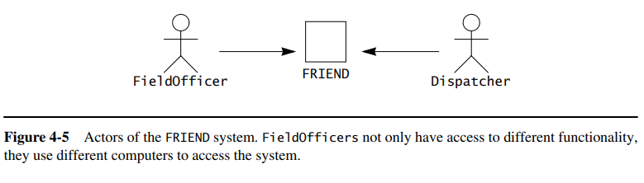
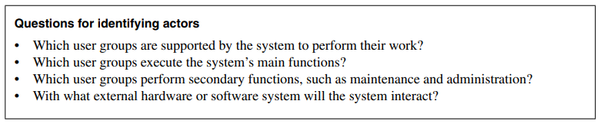
Identifying Actors
Chapter – 4 : Requirements Elicitation

Slide 21
Identifying Scenarios
Chapter – 4 : Requirements Elicitation
A scenario is “a narrative description of what people do and experience as they try to make use of computer systems and applications”. A scenario is a concrete, focused, informal description of a single feature of the system from the viewpoint of a single actor. Scenarios cannot (and are not intended to) replace use cases, as they focus on specific instances and concrete events (as opposed to complete and general descriptions). However, scenarios enhance requirements elicitation by providing a tool that is understandable to users and clients.
Figure 4-6 is an example of scenario for the FRIEND system, an information system for incident response.
In this scenario, a police officer reports a fire and a Dispatcher initiates the incident response. Note that this scenario is concrete, in the sense that it describes a single instance. It does not attempt to describe all possible situations in which a fire incident is reported. In particular, scenarios cannot contain descriptions of decisions.
To describe the outcome of a decision, two scenarios would be needed, one for the “true” path, and another one for the “false” path.

Slide 22
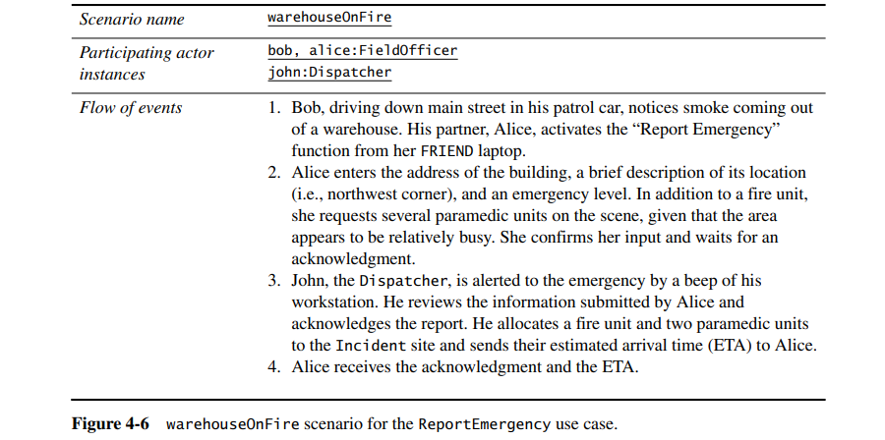
Identifying Scenarios
Chapter – 4 : Requirements Elicitation

Slide 23
Identifying Scenarios
Chapter – 4 : Requirements Elicitation
Scenarios can have many different uses during requirements elicitation and during other activities of the life cycle. Below is a selected number of scenario types:
As-is scenarios describe a current situation. During reengineering, for example, the current system is understood by observing users and describing their actions as scenarios. These scenarios can then be validated for correctness and accuracy with the users.
Visionary scenarios describe a future system. Visionary scenarios are used both as a point in the modeling space by developers as they refine their ideas of the future system and as a communication medium to elicit requirements from users. Visionary scenarios can be viewed as an inexpensive prototype.
Evaluation scenarios describe user tasks against which the system is to be evaluated. The collaborative development of evaluation scenarios by users and developers also improves the definition of the functionality tested by these scenarios.
Training scenarios are tutorials used for introducing new users to the system. These are step-by-step instructions designed to hand-hold the user through common tasks.

Slide 24
Identifying Scenarios
Chapter – 4 : Requirements Elicitation
Questions for identifying scenarios
What are the tasks that the actor wants the system to perform? •
What information does the actor access? Who creates that data? Can it be modified or removed? By whom?
Which external changes does the actor need to inform the system about? How often? When?
Which events does the system need to inform the actor about? With what latency?
In the FRIEND example, we identify four scenarios that span the type of tasks the system is expected to support:
warehouseOnFire (Figure 4-6): A fire is detected in a warehouse; two field officers arrive at the scene and request resources.
fenderBender: A car accident without casualties occurs on the highway. Police officers document the incident and manage traffic while the damaged vehicles are towed away.
catInATree: A cat is stuck in a tree. A fire truck is called to retrieve the cat. Because the incident is low priority, the fire truck takes time to arrive at the scene. In the meantime, the impatient cat owner climbs the tree, falls, and breaks a leg, requiring an ambulance to be dispatched.
earthQuake: An unprecedented earthquake seriously damages buildings and roads, spanning multiple incidents and triggering the activation of a statewide emergency operations plan. The governor is notified. Road damage hampers incident response.

Slide 25
Identifying Use Cases
Chapter – 4 : Requirements Elicitation
A scenario is an instance of a use case; that is, a use case specifies all possible scenarios for a given piece of functionality.
A use case is initiated by an actor. After its initiation, a use case may interact with other actors, as well. A use case represents a complete flow of events through the system in the sense that it describes a series of related interactions that result from its initiation.

Slide 26
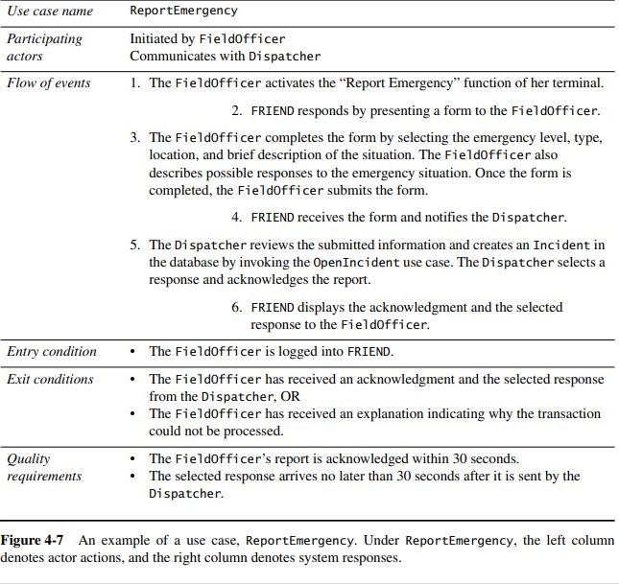
Identifying Use Cases
Chapter – 4 : Requirements Elicitation
Figure 4-7 depicts the use case ReportEmergency of which the scenario warehouseOnFire (see Figure 4-6) is an instance.
The FieldOfficer actor initiates this use case by activating the “Report Emergency” function of FRIEND. The use case completes when the FieldOfficer actor receives an acknowledgment that an incident has been created. The steps in the flow of events are indented to denote who initiates the step.
Steps 1 and 3 are initiated by the actor, while steps 2 and 4 are initiated by the system. This use case is general and encompasses a range of scenarios. For example, the ReportEmergency use case could also apply to the fenderBender scenario. Use cases can be written at varying levels of detail as in the case of scenarios.

Slide 27
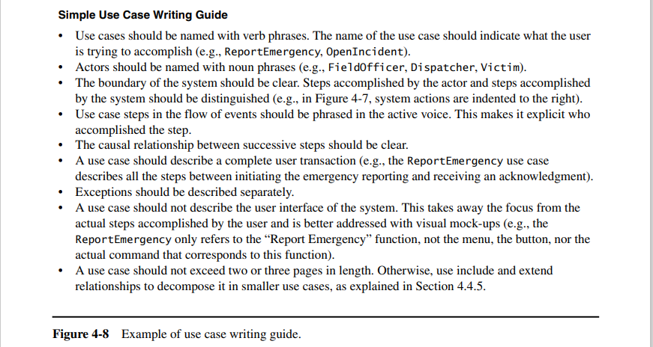
Identifying Use Cases
Chapter – 4 : Requirements Elicitation

Slide 28
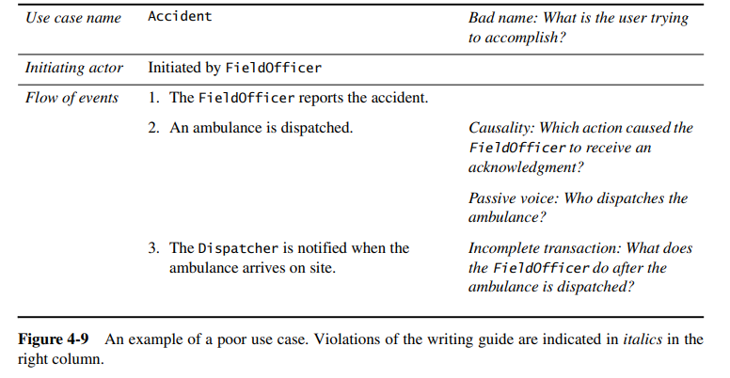
Identifying Use Cases
Chapter – 4 : Requirements Elicitation

Slide 29
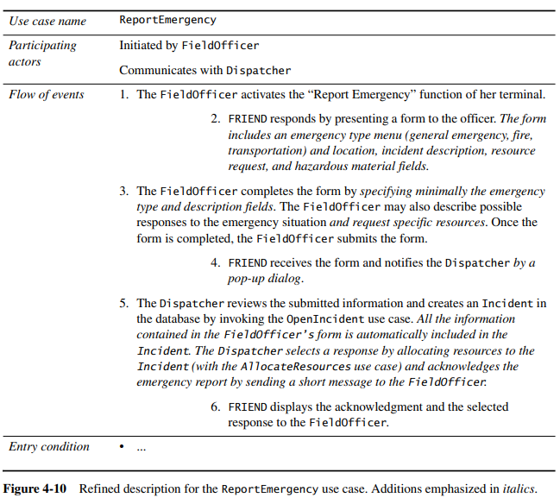
Refining Use Cases
Chapter – 4 : Requirements Elicitation
Figure 4-10 is a refined version of the ReportEmergency use case. It has been extended to include details about the type of incidents known to FRIEND and detailed interactions indicating how the Dispatcher acknowledges the FieldOfficer.

Slide 30
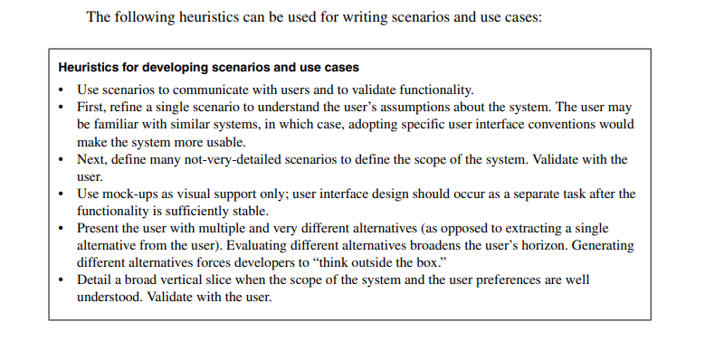
Refining Use Cases
Chapter – 4 : Requirements Elicitation

Slide 31
Identifying Relationships among Actors and Use Cases
Chapter – 4 : Requirements Elicitation
Even medium-sized systems have many use cases. Relationships among actors and use cases enable the developers and users to reduce the complexity of the model and increase its understandability.
We use communication relationships between actors and use cases to describe the system in layers of functionality.
We use extend relationships to separate exceptional and common flows of events.
We use include relationships to reduce redundancy among use cases.

Slide 32
Communication Relationships among Actors and Use Cases
Chapter – 4 : Requirements Elicitation
Communication relationships between actors and use cases represent the flow of information during the use case. The actor who initiates the use case should be distinguished from the other actors with whom the use case communicates.
By specifying which actor can invoke a specific use case, we also implicitly specify which actors cannot invoke the use case. Similarly, by specifying which actors communicate with a specific use case, we specify which actors can access specific information and which cannot.
Thus, by documenting initiation and communication relationships among actors and use cases, we specify access control for the system at a coarse level. The relationships between actors and use cases are identified when use cases are identified.
Figure 4-11 depicts an example of communication relationships in the case of the FRIEND system. The «initiate» stereotype denotes the initiation of the use case by an actor, and the «participate» stereotype denotes that an actor (who did not initiate the use case) communicates with the use case.

Slide 33
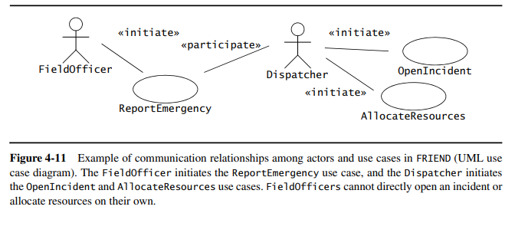
Communication Relationships among Actors and Use Cases
Chapter – 4 : Requirements Elicitation

Slide 34
Extend relationships between use cases
Chapter – 4 : Requirements Elicitation
A use case extends another use case if the extended use case may include the behavior of the extension under certain conditions.
In the FRIEND example, assume that the connection between the FieldOfficer station and the Dispatcher station is broken while the FieldOfficer is filling the form (e.g., the FieldOfficer’s car enters a tunnel). The FieldOfficer station needs to notify the FieldOfficer that his form was not delivered and what measures he should take.
The ConnectionDown use case is modeled as an extension of ReportEmergency (see Figure 4-12). The conditions under which the ConnectionDown use case is initiated are described in ConnectionDown as opposed to ReportEmergency. Separating exceptional and optional flows of events from the base use case has two advantages.
First, the base use case becomes shorter and easier to understand. Second, the common case is distinguished from the exceptional case, which enables the developers to treat each type of functionality differently (e.g., optimize the common case for response time, optimize the exceptional case for robustness). Both the extended use case and the extensions are complete use cases of their own. They each must have entry and end conditions and be understandable by the user as an independent whole.

Slide 35
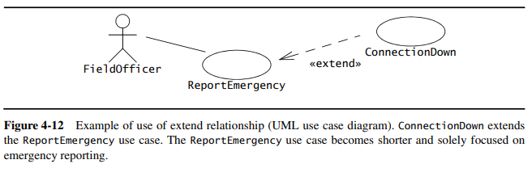
Extend relationships between use cases
Chapter – 4 : Requirements Elicitation

Slide 36
Include relationships between use cases
Chapter – 4 : Requirements Elicitation
Redundancies among use cases can be factored out using include relationships. Assume, for example, that a Dispatcher needs to consult the city map when opening an incident (e.g., to assess which areas are at risk during a fire) and when allocating resources (e.g., to find which resources are closest to the incident).
In this case, the ViewMap use case describes the flow of events required when viewing the city map and is used by both the OpenIncident and the AllocateResources use cases (Figure 4-13).
Factoring out shared behavior from use cases has many benefits, including shorter descriptions and fewer redundancies. Behavior should only be factored out into a separate use case if it is shared across two or more use cases. Excessive fragmentation of the requirements specification across a large number of use cases makes the specification confusing to users and clients.

Slide 37
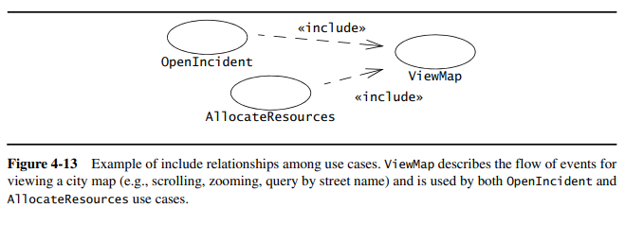
Include relationships between use cases
Chapter – 4 : Requirements Elicitation

Slide 38
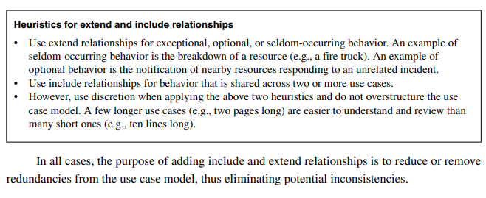
Extend versus include relationships
Chapter – 4 : Requirements Elicitation

Slide 39
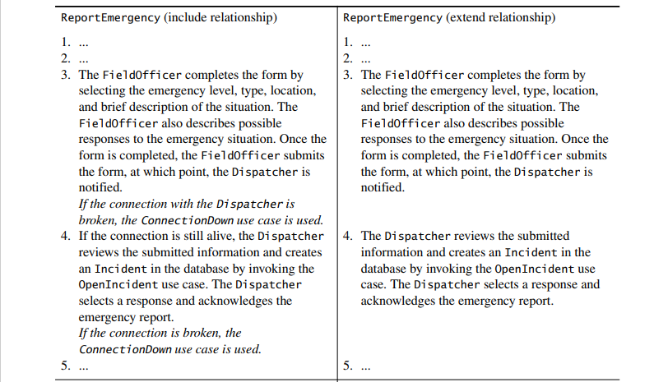
Identifying Initial Analysis Objects
Chapter – 4 : Requirements Elicitation

Slide 40
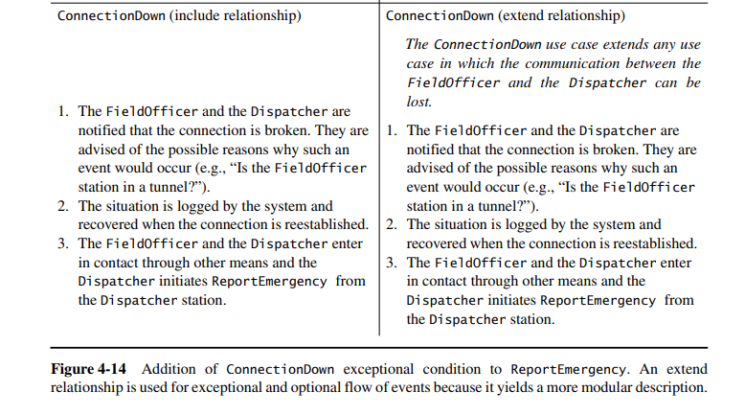
Identifying Initial Analysis Objects
Chapter – 4 : Requirements Elicitation

Slide 41
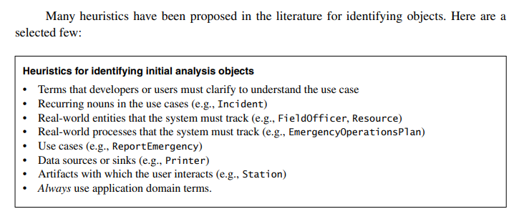
Identifying Initial Analysis Objects
Chapter – 4 : Requirements Elicitation

Slide 42
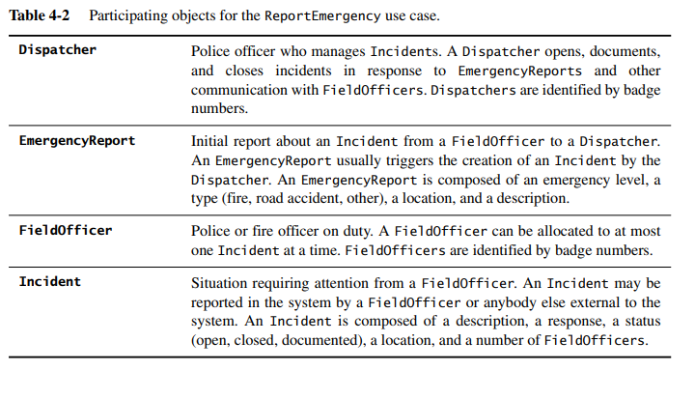
Identifying Initial Analysis Objects
Chapter – 4 : Requirements Elicitation
During requirements elicitation, participating objects are generated for each use case. If two use cases refer to the same concept, the corresponding object should be the same.
If two objects share the same name and do not correspond to the same concept, one or both concepts are renamed to acknowledge and emphasize their difference. This consolidation eliminates any ambiguity in the terminology used.
For example, Table 4-2 depicts the initial participating objects we identified for the ReportEmergency use case.

Slide 43
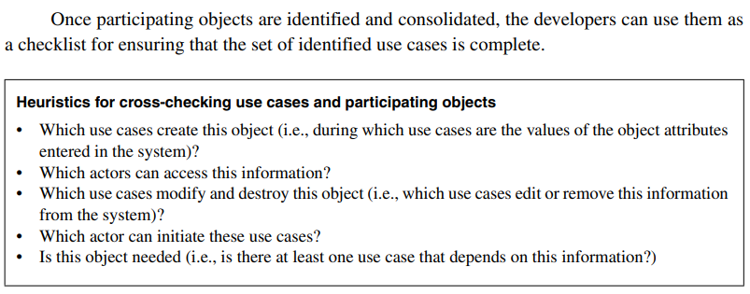
Identifying Initial Analysis Objects
Chapter – 4 : Requirements Elicitation

Slide 44
Identifying Nonfunctional Requirements
Chapter – 4 : Requirements Elicitation
Nonfunctional requirements are aspects of a system not directly tied to its functional behavior. These requirements encompass various issues, including user interface aesthetics, response times, and security considerations. They are defined alongside functional requirements, given their significant impact on system development and cost.
For instance, in the context of an air traffic controller using a mosaic display to track planes, the system's ability to handle a specific number of aircraft influences performance and costs. Balancing the capacity to display multiple aircraft against system complexity and cost is crucial for effective air traffic control.
Nonfunctional requirements can have unexpected effects on user tasks. Effective collaboration between clients and developers is essential to identify critical attributes that may be challenging to achieve but are vital for user functionality. In the mosaic display example, the number of aircraft handled affects various aspects such as icon size, aircraft identification features, and data refresh rate.
The collection of nonfunctional requirements often involves conflicting demands. For instance, in the case of the SatWatch depicted in Figure 4-3, conflicting requirements include the need for accuracy without requiring time resets and a low unit cost, as high accuracy typically correlates with increased costs. Resolving such conflicts involves prioritizing nonfunctional requirements collaboratively between the client and developer, ensuring consistent addressing during system realization.

Slide 45
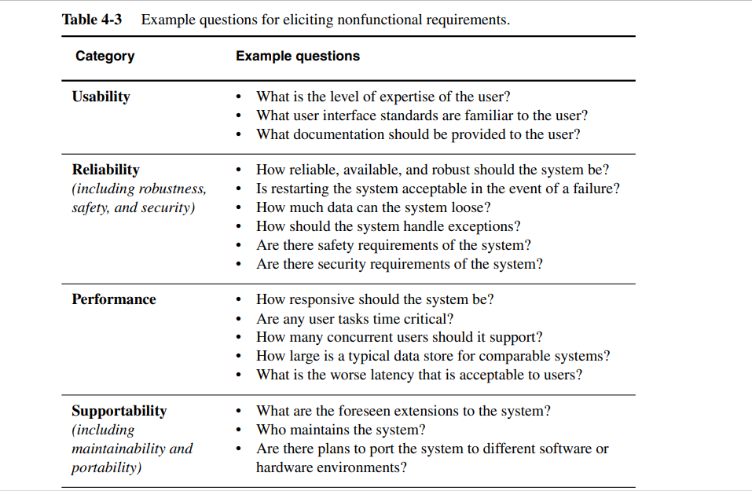
Identifying Nonfunctional Requirements
Chapter – 4 : Requirements Elicitation

Slide 46
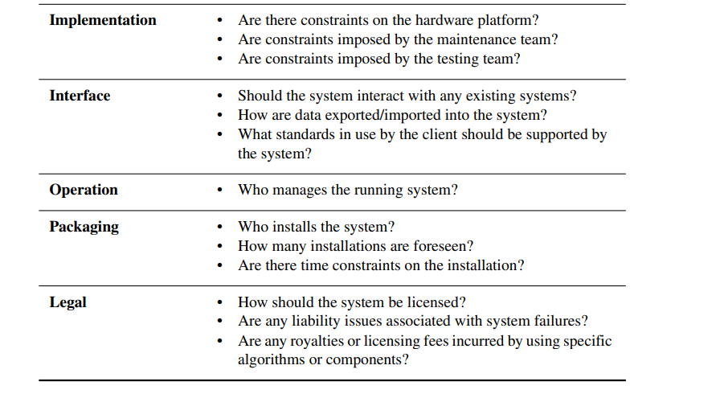
Identifying Nonfunctional Requirements
Chapter – 4 : Requirements Elicitation

Slide 47
THANK YOU

